Slide 1

INSTITUTE UIE
DEPARTMENT ACADEMIC UNIT-2
Bachelor of Engineering (Computer Science & Engineering)
Subject Name Introduction Electrical & Electronics Engineering
Subject Code 23ECH-101
Prepared By
Dr. Shikha
Unit-1 Chapter-1
Introduction to Digital Electronics
Unit-1 Lecture-1
DISCOVER . LEARN . EMPOWER

Slide 2
Vision & Mission of the Department
Vision of the Department | To be recognized as a leading Computer Science and Engineering department through effective teaching practices and excellence in research and innovation for creating competent professionals with ethics, values and entrepreneurial attitude to deliver service to society and to meet the current industry standards at the global level.
Mission of the Department | M1: To provide practical knowledge using state-of-the-art technological support for the experiential learning of our students. M2: To provide industry recommended curriculum and transparent assessment for quality learning experiences. M3: To create global linkages for interdisciplinary collaborative learning and research. M4: To nurture advanced learning platform for research and innovation for students’ profound future growth. M5: To inculcate leadership qualities and strong ethical values through value based education.

Slide 3
Program Educational Objectives
PEO.1 Chandigarh University Computer Science and Engineering graduates will have a bright career as Computer Systems Analyst, Information Security Analyst, Computer Network Architect, Researcher, or Entrepreneur and be able to adapt to the evolving technical challenges and the changing career opportunities. Also, they will learn to effectively communicate ideas in oral written or graphical form and to promote collaboration with other members of engineering teams.
PEO.2 Chandigarh University Computer Science and Engineering graduates will analyse a problem, identify and define the computing requirements appropriate to its solution in addition to the ability to design, implement and evaluate a computer-based system, process, component, or programs to meet desired needs. They will be able to continue to demonstrate the professional skills and communicative abilities necessary to be competent employees assume leadership roles and have career success and satisfaction.
PEO.3 Chandigarh University Computer Science and Engineering Graduates will become productive citizens demonstrating high ethical and professional standards, make sound engineering or managerial decisions, and have enthusiasm for the profession and professional growth.
PEO.4 Chandigarh University Computer Science and Engineering graduates will be successful in modern engineering practice and entrepreneurship, integrate into the local and global workforce, and contribute to the economy of India.
PEO.5 Chandigarh University Computer Science and Engineering graduates will continue to acquire and demonstrate the professional skills necessary to be competent employees, assume leadership roles, and enjoy career success and satisfaction.

Slide 4
Program Outcomes
PO.1 Engineering Knowledge: Apply the knowledge of mathematics, science, engineering fundamentals and an engineering specialization to the solution of complex engineering problems.
PO.2 Problem Analysis: Identify, formulate, review research literature and analyze complex engineering problems reaching substantiated conclusions using first principles mathematics, natural sciences and
engineering sciences.
PO.3 Problem Analysis: Identify, formulate, review research literature and analyze complex engineering
problems reaching substantiated conclusions using first principles mathematics, natural sciences and
engineering sciences.
PO.4 Conduct investigations of Complex Problems: Use research-based knowledge and research methods
including design of experiments, analysis and interpretation of data and synthesis of the information to
provide valid conclusion.
PO.5 Modern Tool Usage: Create, select, and apply appropriate techniques, resources and modern engineering and IT tools including prediction and modelling to complex engineering activities with an understanding of the limitations.
PO.6 The Engineer and Society: Apply reasoning informed by the contextual knowledge to assess societal, health, safety, legal and cultural issues and the consequent responsibilities relevant to the professional engineering practice.

Slide 5
Program Outcomes
PO.7 Environment and Sustainability: Understand the impact of the professional engineering solutions in societal and environmental contexts, and demonstrate the knowledge of, and need for sustainable development
PO.8 Ethics: Apply ethical principles and commit to professional ethics and responsibilities and norms of the
engineering practice.
PO.9 Individual and Teamwork: Function effectively as an individual, and as a member or leader in diverse teams, and in multidisciplinary settings.
PO.10 Communication: Communicate effectively on complex engineering activities with the engineering
community and with society at large, such as, being able to comprehend and write effective reports and
design documentation, make effective presentations, and give and receive clear instructions.
PO.11 Project Management and Finance: Demonstrate knowledge and understanding of the engineering and
management principles and apply these to one’s own work, as a member and leader in a team, to manage projects and in multidisciplinary environments.
PO.12 Life-long Learning: Recognize the need for, and have the preparation and ability to engage in independent and life-long learning in the broadest context to technological change.

Slide 6
Program Specific Outcomes
PSO.1 Chandigarh University Computer Science and Engineering graduates will be able to develop knowledge of Common Business Principles.
PSO.2 Chandigarh University Computer Science and Engineering graduates will be able to understand
contemporary technology, business discipline and service orientation.
PSO.3 Chandigarh University Computer Science and Engineering graduates will be able to understand the
technology abstraction and innovation ability

Slide 7

Lecture Objectives
S. No. | Objectives
1 | To make student aware about the basic concept of digital signals and circuits.
2 | To aware about need digital electronics.
3 | To provide knowledge about advantages and disadvantages of analog and digital electronics.
4 | To give brief knowledge about conversion of analog to digital signals.
Figure showing same application but different technology

Slide 8
Course Objectives
S. No. | Objectives
1 | To understand Merits of digitization.
2 | To enable you to understand common forms of number representation in digital electronic circuits and to be able to convert between different representations.
3 | To Impart Knowledge about various digital circuits and designing of systems
Figure showing same application but different technology

Slide 9
Course Outcomes
CO Number | Title | Level
CO1 | To indentify the different types of digital circuits and their difference and to illustrate the various types of gates. | Remember
CO2 | To understand the various elements of digital system and to implement their applications. | Understand
CO3 | To illustrate the relation between Combinational & Sequential Circuits and to apply for practical applications. | Analyze
CO4 | To solve the basic problems related to different types of digital circuits and to calculate it using various numerical problems. | Evaluate
CO5 | To create different hardware and software based digital applications. | Create
Figure showing same application but different technology

Slide 10
CO-PO Mapping
CO-PO Mapping
Course Outcome | PO1 | PO2 | PO3 | PO4 | PO5 | PO6 | PO7 | PO8 | PO9 | PO10 | PO11 | PO12 | PSO1 | PSO2 | PSO3
CO1 | 3 | 2 | 1 | 1 | 0 | 0 | 0 | 0 | 0 | 0 | 0 | 2 | 2 | 0 | 0
CO2 | 3 | 2 | 1 | 1 | 0 | 0 | 0 | 0 | 0 | 0 | 0 | 2 | 2 | 0 | 0
CO3 | 3 | 2 | 1 | 1 | 0 | 0 | 0 | 0 | 0 | 0 | 0 | 2 | 2 | 0 | 0
CO4 | 3 | 2 | 1 | 1 | 0 | 0 | 0 | 0 | 0 | 0 | 0 | 2 | 2 | 0 | 0
CO5 | 3 | 2 | 1 | 1 | 0 | 0 | 0 | 0 | 0 | 0 | 0 | 2 | 2 | 0 | 0

Slide 11

Introduction to Digital Electronics
What is digital electronics?
Analog vs. Digital
How conversion of analog to digital occur?
Benefits of Digital over analog
Advantages & Disadvantages of digital Electronics
Applications of digital electronics
Digital Signal Representation
Figure: Digital data & signal representation

Slide 12
What is Digital Electronics?
Digital electronics deals with the electronic manipulation of numbers, or with the manipulation of varying quantities by means of numbers. Because it is convenient to do so, today's digital systems deal only with the numbers 'zero' and 'one', because they can be represented easily by 'off and 'on' within a circuit.
Digital stand for digit, digital electronics basically has two conditions which are possible, 0 (low logic) and 1 (high logic).
Digital electronic systems use a digital signal that are composed of mathematical features to work.
"1" as true and "0" as false are called bit and the group of bits are named byte.
Digital electronic circuits are usually made from large assemblies of logic gates.
Digital describes electronic technology that generates, stores, and processes data in terms of two states: 1 and number 0.

Slide 13
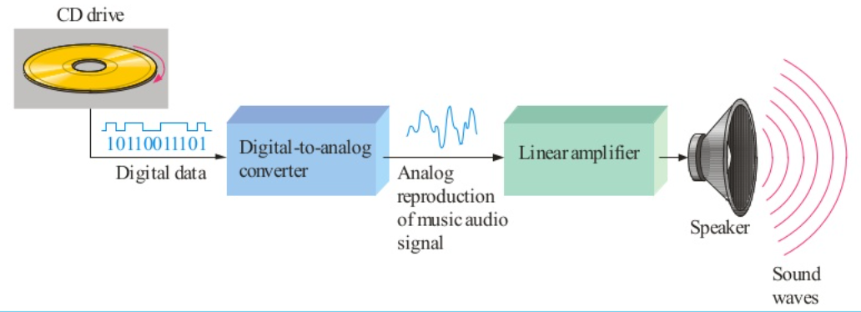
Analog Vs Digital
Many systems use a maximum of analog and digital electronics to take advantage of each technology. ▪ Example: A typical CD player accepts digital data from the CD drive and converts it to an analog signal for amplification. Digital data CD drive 10110011101 Analog reproduction of music audio signal Speaker Sound waves Digital-to-analog converter Linear amplifier
Figure: Example Analog vs digital

Slide 14
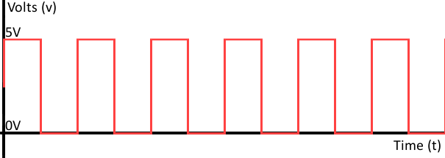
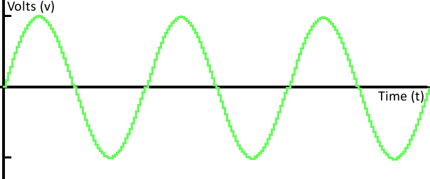
Analog Signal Vs Digital Signal Representation
Figure: Digital signal Comprises of only two values
High by 1 bit(5V) & Low by 0 bit(0V)
Figure: Analog Signal comprises of infinite values
between given limits

Slide 15
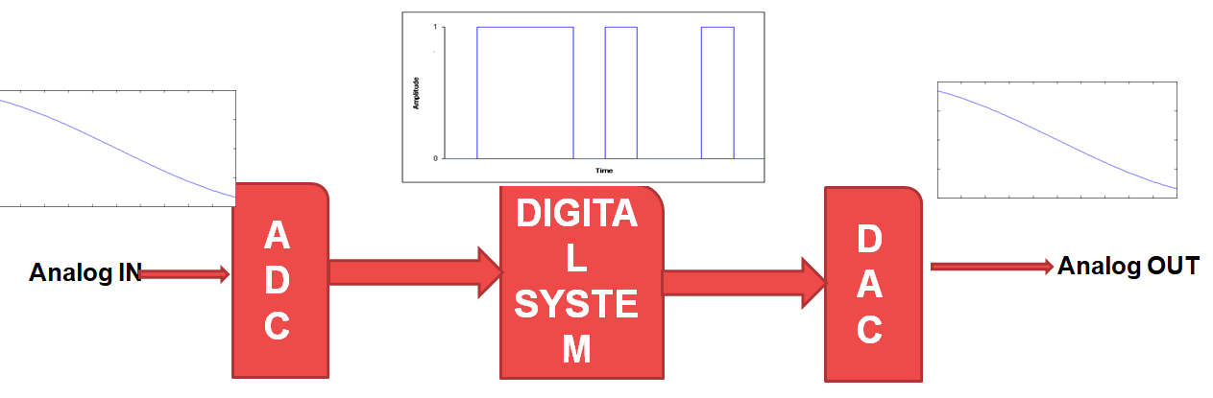
How the conversion of Analog to Digital Occur?
Analog to Digital converter
Digital to Analog converter
Figure : Conversion of analog to digital

Slide 16
Benefits of Digital over Analog
Reproducibility
Not effected by noise
Ease of design
Data protection
Programmable
High speed communication

Slide 17
Advantages of Digital Electronics
Computer-controlled digital systems can be controlled by software, allowing new functions to be added without changing hardware.
Information storage can be easier in digital systems than in analog ones.
The noise-immunity of digital systems permits data to be stored and retrieved without noise.
In a digital system are easier to design and more precise representation of a signal can be obtained by using more binary digits to represent it.
More digital circuitry can be fabricated on IC chips.
Error management method can be inserted into the signal path. To detect errors, and then either correct the errors, or at least ask for a new copy of the data.

Slide 18
Disadvantages of Digital Electronics
Conversion to digital format and re-conversion to analog format is needed, which always include the lost of information.
In some cases, digital circuits use more energy than analog circuits and produce more heat and need heat sinks.
Digital circuits are sometimes more expensive, especially in small quantities.

Slide 19
Applications of Digital Electronics
It's application are infinite, ranging for high end computing to miniature circuits that can be very versatile, signal processing, communication etc. Digital Electronics is currently rapidly developing and removing conventional analogue machines due to its high speed, more accuracy and greater flexibility
Figure: Applications of Digital

Slide 20
Applications of Digital Electronics
The digital system send the data in the form of packets of digital codes, thus we can encode and decode them in various formats and codes.
Data encryption is also possible in the digital systems, hence the data transmission is more secure, and can be manipulated in many formats
Digital systems are much advantageous in communications Data Transmission using Digital Systems

Slide 21
Summarization
Today’s fast growing technology need the evolution of digital electronics.
Speed ,Space & Accuracy are key parameters of digital system.
Every signal is by default analog in nature but as per the need conversions are done to make it work in digital system.
Infinite application can be seen around which very well explain the need of digital electronics

Slide 22
REFERENCES
https://www.google.com/search?q=number+system+in+digital+electronics&source=lnms&tbm=isch&sa=X&ved=0ahUKEwjOsbqmnvPiAhXPZCsKHXrSBJYQ_AUIESgC&biw=1366&bih=657#imgrc=DBR-RpBVZAmHDM:
https://www.google.com/search?q=decimal+to+binary&source=lnms&tbm=isch&sa=X&ved=0ahUKEwi6nMvW5uHiAhVBXSsKHUgGC60Q_AUIECgB&biw=1517&bih=730#imgrc=cl-xz1ixddfv9M
www.cse.yorku.ca/~mack/1011/01.NumberSystems.ppt
https://www.google.com/search?q=binary+to+grey+conversion&source=lnms&tbm=isch&sa=X&ved=0ahUKEwjD6vrQi-PiAhVMSX0KHftLDngQ_AUIECgB&biw=1366&bih=657#imgrc=bkt5qsZlpTZ1sM
http://www.geeksforgeeks.org/digital-electronics-logic-design-tutorials/
https://www.google.com/search?q=binary+to+grey+conversion&source=lnms&tbm=isch&sa=X&ved=0ahUKEwjD6vrQi-PiAhVMSX0KHftLDngQ_AUIECgB&biw=1366&bih=657#imgrc=bkt5qsZlpTZ1sM
http://www.ni.com/example/14493/en/
https://www.tutorialspoint.com/digital_electronics/index.asp
https://www.tutorialspoint.com/computer_logical_organization/complement_arithmetic.htm
Floyd & Jain, Digital Fundamentals, Pearson.
Mano, Morris, Digital Design, Prentice Hall of India.
Fletcher, An Engineering Approach to digital design, Prentice Hall of India.

Slide 23
References
Video link for Digital Electronics
https://www.youtube.com/watch?v=2xXErGeeb_Q
https://www.youtube.com/watch?v=M0mx8S05v60&list=PLBlnK6fEyqRjMH3mWf6kwqiTbT798eAOm
E Book for Digital Electronics
https://www.electronicsforu.com/resources/15-free-electronics-ebooks
Other important link
NPTEL
https://nptel.ac.in/courses/108/105/108105132/
https://nptel.ac.in/courses/117/106/117106086/
https://executivefunctioningsuccess.com/wp-content/uploads/2010/06/analog-vs-digital.png
http://www.technologyuk.net/telecommunications/telecom-principles/images/digital_signal02.gif

Slide 24
THANK YOU

